Slide 1
The Concepts of Business Intelligence

Slide 2

Business Intelligence (BI) Agenda
Notes:
The section, though somewhat technical, it avoids a deep technical discussion as it's aimed at both technology and business students. It seeks to prepare the technology students for the concepts in the session about the technical aspects of BI, while providing business students with an understanding of the challenges and steps necessary to create a BI solution that delivers business value.

Slide 3
Business Intelligence – Why ?
“You’ve got to make it easy for business people to get at the data directly.”
“Just show me what is important.”
“It drives me crazy to have two people present the same business metrics at a meeting, but with different numbers.”
“We want people to use information to support more fact-based decision making.”
“We have mountains of data in this company, but we can’t access it.”

Slide 4
Business Intelligence – Why ?

Slide 5
Business Intelligence – Why ?

Slide 6
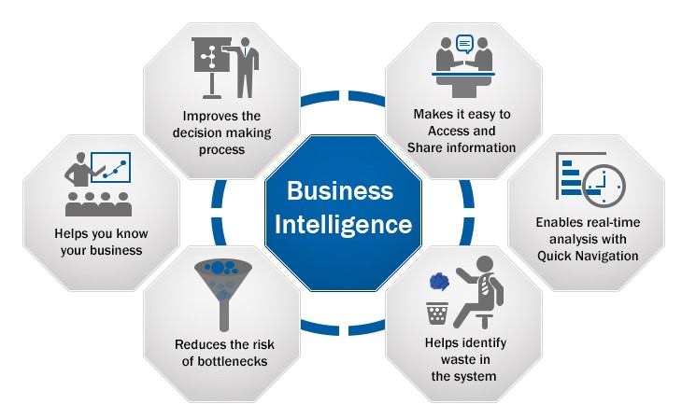
Business Intelligence – Why ?

Slide 7
Time levels of analytics

Slide 8
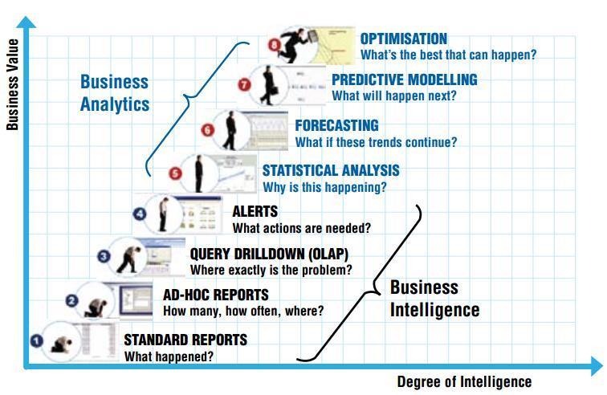
Eight levels of analytics
Future
Present
Past

Slide 9
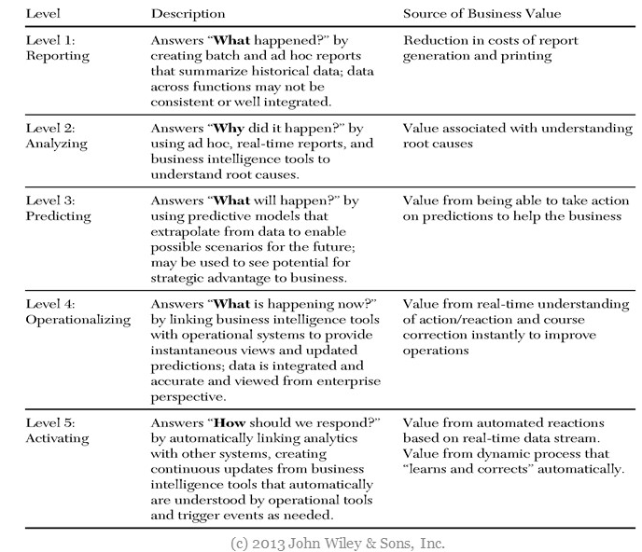

Slide 10
strategic stakeholder questions
OPERATIONAL (closed-ended questions) | INFORMATIONAL (open-ended questions)
How many knives were in school today? | What trends regarding weapons in school exist?
Which students in which schools were absent today? Of those who were absent today, which were absent yesterday? | How do absences affect student achievement?
What professional development activities have certified reading teachers taken this year to date? | What effect does professional development have on the reading portion of the proficiency test?
What are all the reading initiatives in the district? | Which are the most effective reading programs? What best practices exist for reading programs?
How many students have 4 consecutive unexcused absences this month? | What are social factors contribute to unexcused absences (e.g., childcare, pregnancy)? What interventions can the county help with?
How many teachers are teaching math and science? By school? | What effect on student achievement does multiple teachers teaching a single subject have?

Slide 11
Business Intelligence (BI)
“The processes, technologies and tools needed to turn data into information and information into knowledge and knowledge into plans that drive profitable business action.

Slide 12
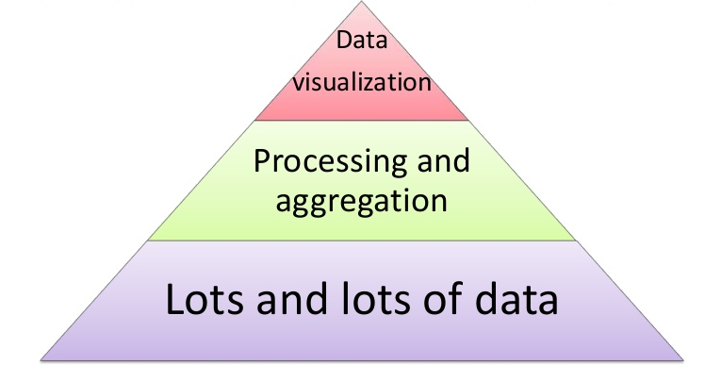
Business Intelligence (BI)
Business intelligence (BI) is a set of theories, methodologies, architectures, and technologies that transform raw data into meaningful and useful information for business purposes.

Slide 13
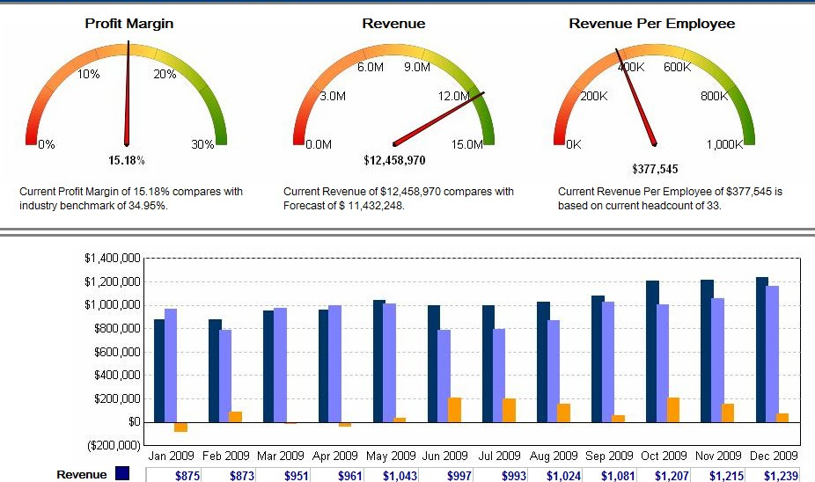
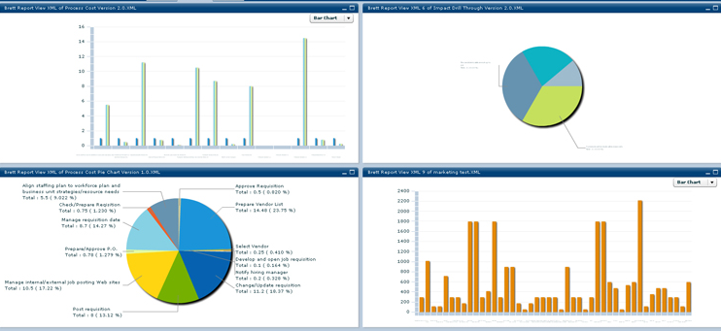
Business Intelligence (BI)
Reports
Data repository
Different systems

Slide 14
demo
Here are some questions we answer in this demo:
“What are the top 10 product categories?”
“What is the average unit price for each category?”
“How many orders did we have for each category?”
“Who are the sales reps selling in each category?”
“Which categories make up over 50% of our total revenue?”
Notes:
Sales Trends:

Slide 15
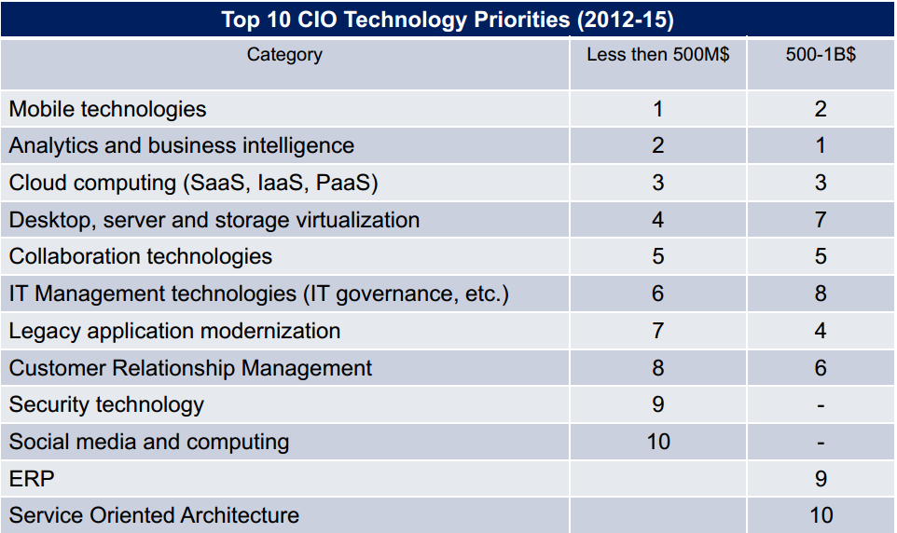
Top 10 cio technology priorities

Slide 16
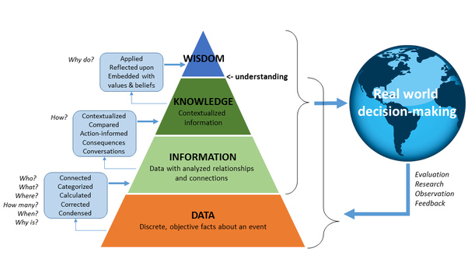
Business Intelligence (BI)

Slide 17
Business Intelligence (BI)
BI encompasses:
Data warehousing
Business analytics
Knowledge management.

Slide 18
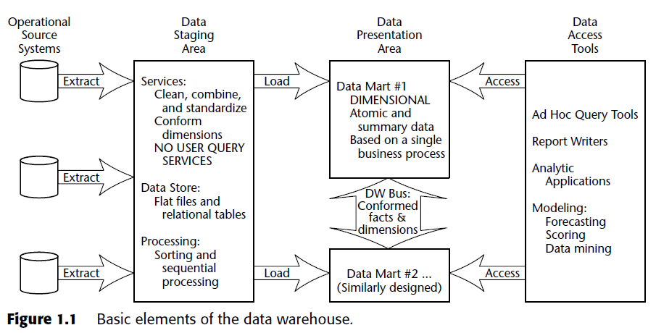
Basic Elements of the Data Warehouse
ETL – Extract > Transform > Loading
Notes:
There are a number of components that make up a “data warehouse.”
A “data warehouse” and “data mart” are built exactly the same way;
the only difference is the scope
1. (a “warehouse” is for the entire business,
2. a “mart” is for a business functional area.)
The terms listed here are defined on the next few slides.

Slide 19
Basic Elements of the Data Warehouse
Notes:
There are a number of components that make up a “data warehouse.”
A “data warehouse” and “data mart” are built exactly the same way;
the only difference is the scope
1. (a “warehouse” is for the entire business,
2. a “mart” is for a business functional area.)
The terms listed here are defined on the next few slides.

Slide 20
Basic Elements of the Data Warehouse
Notes:
There are a number of components that make up a “data warehouse.”
A “data warehouse” and “data mart” are built exactly the same way;
the only difference is the scope
1. (a “warehouse” is for the entire business,
2. a “mart” is for a business functional area.)
The terms listed here are defined on the next few slides.

Slide 21
Basic Elements of the Data Warehouse
A data repository that makes operational and other data accessible in a form that is readily acceptable for decision support and other user applications.
Note: A data warehouse is not another word for a database. The specific purpose of a data warehouse is to support decisions not operations.

Slide 22
The Components of a Data Warehouse
There are several items that make up a data warehouse
Key Performance Indicators
Sales
Cubes
Show me sales by month by product for North America
Measures
What you want to see (sales in this case) is called a measure
Dimensions
How you want to see it (month, product, and North America) is called a dimension
Attributes
Hierarchies
Notes:
In order to retrieve data from a warehouse, it helps to know the components of a question. Typically users ask to see “something” (sales, expenses, number of units, etc.) segmented “by” certain things (time, location, salesperson, and so forth.)
What people want to see are usually numeric and they are called measures. Measures are the basis for KPIs.
How the data should be segmented are called dimensions.
These measures, and dimensions, are stored in cubes.

Slide 23
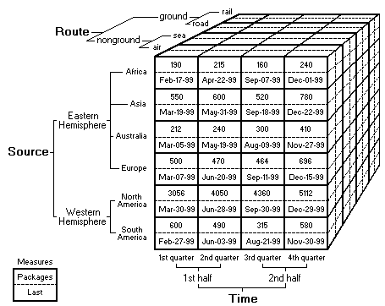
Cubes
Cubes are the structures in which data is stored
Users access data in the cubes by navigating through various dimensions
Notes:
A cube is the basic building block of a data warehouse. A warehouse may contain one or more cubes. A cube is a multidimensional structure that holds data based on dimensions.
Consider an example of a data warehouse for a shipping company/organization such as FedEx, UPS, or USPS. In this diagram, there are three dimensions shown: Time, Source, and Route. At each intersection of Time, Source, and Route is a cell. Within that cell are two measures: the number of packages and the date one was shipped. This is far different from a relational setup: relational databases are two-dimensional (rows and columns) and each cell can have only a single value.

Slide 24
Measures
Measures are what you want to see
They are almost always numeric
They are often additive
Dollar sales, unit sales, profit, expenses, and more
Some measures are not additive
Date of last shipment
Inventory counts and number of unique customers
Notes:
Measures are the “what” people want to see. They are almost always numeric. They are often additive, but not always. Measures may be KPIs or serve as the basis of KPIs. Unlike in a relational schema, in a cube you would typically want to store calculated values in order to make retrieval faster, and most cubes include the concept of calculated measures.

Slide 25
Dimensions
Dimensions are how you want to see the data
You usually want to see data by time, geography, product, account, employee, …
Dimensions are made up of attributes and may or may not include hierarchies
Year – Semester – Quarter – Month – Day
Product Category – Product Subcategory - Product
Notes:
Dimensions are how people like to segment, or slice, the data. Almost anytime someone asks a question, they describe how they want to see it. For example, sales by store by month. Cubes may contain many dimensions, but the more dimensions that are available, the more challenging it is for non-technical users to explore.

Slide 26
Attributes
Attributes are individual values that make up dimensions
A Time dimension may have a Month attribute, a Year attribute, and so forth
A Geography dimension may have a Country attribute, a Region attribute, a City attribute, and so on
A Product dimension may have a Part Number attribute, a size attribute, a color attribute, a manufacturer attribute, and more
Notes:
Attributes represent different ways of looking at something in a dimension. For example, in a product dimension, a user might want to compare the sales of a product by color; is the red product selling better than the blue? Does it depend on which area of the country is examined? Many of the columns in a relational table can become attributes in a warehouse. When looking at employees, attributes such as age, sex, race, postal code, and more, all make sense for performing analysis.

Slide 27
Hierarchies
You can put attributes into a hierarchical structure to assist user analysis
One of the most common functions in BI is to “drill down” to a more detailed level
For example, Time hierarchy might be to go from Year to Quarter to Month to Day
Another Time hierarchy might go from Year to Month to Week to Day to Hour
Notes:
Most dimensions contain hierarchies which allow users to drill down on data. For example, a Time dimension often has a Year level which can then be broken down into Quarters. Quarters can then be broken into Months, and finally Days. Values in the cube are physically stored at the lowest level of granularity but summarized values are stored at each higher level of the dimension, so when a user asks to see Quarterly data, the value is already stored and retrieval is nearly instantaneous.

Slide 28
Building BI Solutions - Challenges
Data
Process
Tracking
Analytics
&
People
Geography
Notes:
There are a number of challenges with BI.
1/ First, there are technical issues:
a/ disparate data,
b/ different operating systems,
c/ different database platforms, and more.
This data is usually stored in an OLTP format designed for fast inserts, updates, and deletes, not analysis.
2. Some challenges are human issues: different workers have different levels of expertise for working with data and therefore need different tools.
3. Other challenges are business challenges: what data should be available and to whom and what level.

Slide 29
Consolidation of Data
Data
Moving data, making it consistent, and cleaning up the data as much as possible
Data is frequently stored in different formats
Data is frequently inconsistent between sources
Data may be dirty
Internally inconsistent or missing values
Notes:
The first step in building a BI solution is to consolidate data. There are many challenges here, such as distributed data being inconsistent. Data is often “dirty” which means bad data has crept into the system. These data challenges are covered on the next three slides.

Slide 30
Disparate Data (Moving)
Data
Data in a variety of locations and formats:
Relational databases (operational data systems)
XML files
Desktop databases
Microsoft ® Excel™ spreadsheets
The data may also be in databases on different operating system and hardware platforms
Notes:
The data is often distributed throughout an organization. A company might have custom applications that use Microsoft SQL Server, purchased applications that use Oracle, employees storing data in Microsoft Excel, and data arriving in XML format. In addition, SQL Server may be running on Windows Server 2003 while Oracle may be running on a Unix server. In order to perform any analysis, data must be consolidated. In the vast majority of cases, the data is physically consolidated on a single server; however, in some rare cases, it is accessed directly where it is. This is rarely done because accessing the data where it resides has an adverse impact on the performance of those OLTP system.

Slide 31
Inconsistent Data (consistency)
Data
Data may be inconsistent
Two plants might have different part numbers for the same physical part
To represent True and False, one system may use 1 and 0, while another system may use T and F
Data stored in different countries will likely store sales in their local currency
These sales must be converted to a common currency
Notes:
Data is often stored in inconsistent formats. True and False are often represented differently in different systems; True may be 1, 0, T, True, or some binary value that means “true.” Revenues and expenses are often recorded in the local currency, creating a challenge for multinational corporations. Different systems may have different part number or employee IDs. In order to do any sort of analysis, all of these issues must be corrected; data must be made consistent before analysis can be performed.

Slide 32
Data Quality Issues (Cleaning)
Data
Clean data facilitates more accurate analysis
Many data entry systems allow free-form data entry of text values
For example, the same city might be entered as Louisville, Lewisville, and Luisville
Routines to clean up data need to take into account all possible variations of bad data
Notes:
Virtually all companies have dirty data. Dirty data are bad values that enter a system. It can be a simple typo when entering a number, but it is often a bad value entered into a free-form text field. For example, sales may be attributed to employee IDs that don’t exist in the Employees system, city names might be spelled many different ways, and so forth. Cleaning up bad data can require extensive routines that require updating each time a new bad value is encountered. Organizations can also use data mining algorithms to help clean up data; for example, a fuzzy lookup can be used to help match text values that are similar.

Slide 33
Extraction, Transformation, and Loading (ETL)
Data
The process of data consolidation is often called Extraction, Transformation, and Loading (ETL)
The ETL process extracts data from the various source systems
Data is then transformed to make it consistent and improve data quality
The consolidated, consistent, and cleaned data is then loaded into a data repository
Developing the ETL process often consumes 80% of the development time
Notes:
The process of moving data from its source systems, consolidating it in a central location, and fixing data inconsistencies is called Extraction, Transformation, and Loading, or ETL. The extraction step is pulling the data from various source systems. It is then transformed, or made consistent (“True” values are all set to the same, currencies are converted, and so forth.) Finally, it is loaded into a data repository (often called a data factory or data warehouse.)

Slide 34
Business Issues with Data Consolidation
Process
Business users must drive what should be in the data warehouse
Someone in the business must decide how to consolidate inconsistent data
If True is 1 in one system and T in another, what should the value be once the data is consolidated from the two systems?
The business must decide how to handle other necessary items - such as currency conversions
Notes:
There are a number of business issues with data consolidation, and unfortunately politics can come into play. Different groups always want to argue that “their” data is correct and no one else’s is. The business must decide what values to use when different systems store the same value differently, and this is especially contentious if different systems store the same product or part with different values. Currency conversions must be made to a common currency, and the format of this currency is another business decision.

Slide 35
Supporting Different Types of Users
People
One of the great benefits of BI is that it can support the data needs of the entire business
This support comes from the many different ways that users can consume BI data
Different tools exist to support these different data needs
Notes:
There are many different tools that can be used against a common BI database. These different tools support a wide variety of users with different needs when working with data.

Slide 36
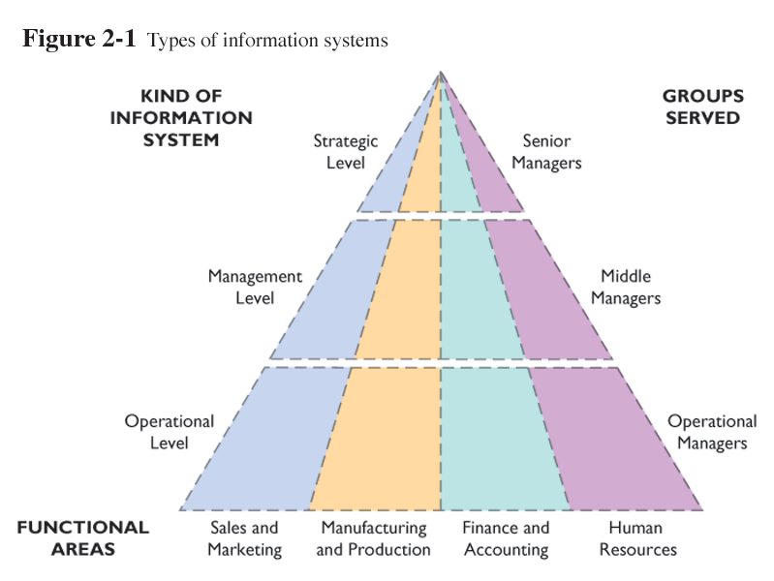
The Users of Business Intelligence
People
Notes:
The users of BI can be broken down into:
High-level users with the need for a broad view and limited analytics capabilities
Those specialized users who perform detailed data analysis and need powerful tools
Workers who need basic reports with possible analytic features
Workers who have BI built into the systems they use without realizing it is BI

Slide 37
The Users of Business Intelligence
People
Executives and business decision makers look at the business from a high level, performing limited analysis
Analysts perform complex, detailed data analysis
Information workers need static reports or limited analytic power
Line workers need no analytic capabilities as BI is presented to them as part of their job
Notes:
The users of BI can be broken down into:
High-level users with the need for a broad view and limited analytics capabilities
Those specialized users who perform detailed data analysis and need powerful tools
Workers who need basic reports with possible analytic features
Workers who have BI built into the systems they use without realizing it is BI

Slide 38
Supporting Different Types of Users
Analysts
People
Focus needs to shift from loading/validating data
to performing analysis
Ad hoc platform capabilities need to be provided for varied/quick analysis
Sales Force
Needs integrated customer view, high quality actionable
reports and quick turnaround
IT
Requires automated solutions to reduce operational
support/cost, efficient architecture to reduce code base, minimal effort to input data into the system
Lack of well-defined roles and responsibilities
Lack of data stewards with the right mix of skills
Lack of appropriate training and coaching
Lack of data governance for compliance
Notes:
There are many different tools that can be used against a common BI database. These different tools support a wide variety of users with different needs when working with data.

Slide 39
Geography challanges
Geography
Currency
Market Structure
Language

Slide 40
The Approaches to Consuming Business Intelligence
Scorecards
Customized high-level views with limited analytic capabilities
Reports
Standardized reports aimed at a large audience, with no or limited analytic capabilities
Analytics Applications
Applications designed to allow complex data analysis
Custom Applications
Embed BI data within an application
Notes:
There are many different approaches to consuming BI. Different approaches can map to multiple groups of users.

Slide 41
Analytics techniques – types of model
Simulation
Decision analysis
Statistics : averages, correlations,
Linear programming: optimisation
Queuing theory: “waiting line” analysis
Network analysis: Maximise flow through a network e.g. A supply chain
Multi-criteria decision making: scoring models

Slide 42
Analytics techniques – OLAP on line analytics process
OLAP enables you to look at and access data in different ways (3-d data cubes) , drill down, view summarised data, make calculations on the fly etc.

Slide 43
Analytics techniques – data mining
Data mining is a capability to support the recognition of previously unknown but potentially useful relationships within large databases/ data warehouses.
Basically software to analyse data and spot patterns.

